Slide 1
Introduction to Information Security
Detailed Overview | Book-Style Presentation

Slide 2
Overview
In the digital era, information has become one of the most valuable assets for individuals, businesses, and governments. From personal identity records and banking transactions to corporate trade secrets and national defense strategies, the protection of information has emerged as a crucial priority.
Information Security (often abbreviated as InfoSec) is the practice of defending information or digital data from unauthorized access, misuse, disclosure, destruction, alteration, or disruption. It is not just about technology; it involves policies, procedures, and human awareness to ensure data is secure throughout its lifecycle.

Slide 3
Definition
Several well-known organizations have provided formal definitions of information security:
- National Institute of Standards and Technology (NIST):
'The protection of information and information systems from unauthorized access, use, disclosure, disruption, modification, or destruction.'

Slide 4
Introduction to Information security
In today’s digital era, information has become one of the most valuable assets for individuals, organizations, and governments. With the rapid growth of technology, internet connectivity, and digital transformation, securing information has become critical for ensuring confidentiality, integrity, and availability (commonly referred to as the CIA triad) of data.

Slide 5
It encompasses a wide range of domains, including network security, application security, cloud security, cryptography, identity and access management, risk management, and incident response. These elements work together to safeguard sensitive information against evolving cyber threats such as malware, phishing, ransomware, denial-of-service (DoS) attacks, and insider threats.

Slide 6
Types of information security
Information Security is a broad field that addresses the protection of data across different environments and technologies. It can be categorized into several types, each focusing on specific aspects of securing information:
Network Security
Protects the integrity, confidentiality, and accessibility of data as it is transmitted across networks.

Slide 7
Involves securing both hardware and software technologies.
Techniques include firewalls, intrusion detection, VPNs, secure routers, and encryption.
Defends against threats such as unauthorized access, malware, denial-of-service (DoS) attacks, and man-in-the-middle (MITM) attacks.

Slide 8
2. Application Security
Focuses on ensuring that software applications are secure from vulnerabilities.
Involves secure coding practices, application testing, and patch management.
Tools and practices include web application firewalls (WAF), penetration testing, input validation, and API security.
Protects against SQL injection, cross-site scripting (XSS), and buffer overflow.

Slide 9
3. Cloud Security
Deals with safeguarding data, applications, and services hosted in cloud environments.
Shared responsibility between cloud service providers (CSPs) and users.
Includes data encryption, identity management, access controls, and compliance with standards.
Addresses risks like data breaches, account hijacking, and misconfigured cloud settings.

Slide 10
4. Endpoint Security
Endpoint Security focuses on securing end-user devices such as computers, mobile phones, IoT devices, and servers. Since endpoints are common entry points for attackers, they must be strongly protected.
Tools include antivirus software, endpoint detection and response (EDR), and device management solutions. Endpoint security protects against threats that originate at or target end-user devices.

Slide 11
5. Data Security
Data Security ensures that sensitive data is protected both in storage and in transit.
Methods include data masking, encryption, tokenization, and backup solutions.
Data security protects critical assets such as intellectual property, customer information, and financial data from breaches, unauthorized access, and loss.

Slide 12
6. Identity & Access Management
Identity and Access Management ensures that only authorized users have access to specific resources.
It involves authentication, authorization, role-based access control, and multi-factor authentication. IAM minimizes insider threats and prevents unauthorized access to sensitive systems and data.

Slide 13
7. Operational Security (OPSEC)
Operational Security focuses on the processes, policies, and procedures that govern how information is protected.
It involves risk management, incident response planning, audits, and security awareness training.
OPSEC helps organizations maintain their security posture through both administrative and human-centric controls.

Slide 14
8.Cryptography & Information Assurance
Cryptography ensures confidentiality and integrity of information through encryption and decryption.
It also supports secure communication, digital signatures, and authentication protocols.
Cryptography plays a critical role in secure financial transactions, e-commerce, and digital identities, thereby ensuring information assurance.

Slide 15
The main types of information security include:
- Network Security
- Application Security
- Cloud Security
- Endpoint Security
- Data Security
- Identity & Access Management
- Operational Security
- Cryptography & Information Assurance
These work together as layers of protection in a strategy known as Defense-in-Depth, ensuring that if one layer is compromised, others continue to safeguard information assets.

Slide 16
Need for Information Security
Why Information Security is Essential in the Digital Era

Slide 17
Protection of Sensitive Data
Organizations and individuals store vast amounts of confidential information, such as financial data, intellectual property, personal records, and health information.
Unauthorized access or leakage of this data can result in identity theft, fraud, or competitive disadvantage.
Information Security ensures the confidentiality, integrity, and availability (CIA triad) of such critical data.

Slide 18
Prevention of Cyber Threats and Attacks
Cyberattacks such as malware, phishing, ransomware, and denial-of-service are rising in frequency and sophistication.
Without proper security, systems remain vulnerable to data breaches, system downtime, and financial losses.
Security measures like firewalls, intrusion detection, encryption, and access control reduce the risk of such attacks.

Slide 19
Maintaining Business Continuity
Any compromise of information systems can disrupt business operations, leading to financial losses, reduced productivity, and damaged reputation.
Strong information security strategies, including backup and disaster recovery, ensure that organizations can continue to function even after an incident.

Slide 20
Regulatory and Legal Compliance
Many industries are governed by laws and standards such as GDPR, HIPAA, PCI-DSS, and ISO/IEC 27001.
Non-compliance with these regulations can result in heavy penalties, legal consequences, and loss of trust.
Information Security ensures that organizations adhere to required compliance frameworks.

Slide 21
Protecting Reputation and Trust
Trust is a key factor for customers, clients, and partners in the digital economy.
Data breaches or misuse of information can lead to loss of credibility, public backlash, and reduced market value. Effective security practices build confidence and trustworthiness.

Slide 22
Safeguarding National Security and Critical Infrastructure
Governments and public institutions rely on information systems for defense, public safety, healthcare, and infrastructure management.
Cyberattacks on these systems can have serious consequences on national security and citizens’ lives. Strong cybersecurity ensures the resilience of critical infrastructure against threats.

Slide 23
Conclusion
The need for Information Security arises from the growing dependence on digital systems, the increasing sophistication of cyber threats, and the critical importance of data in modern life.
By ensuring data confidentiality, integrity, and availability, information security protects individuals, organizations, and nations from financial, reputational, legal, and security risks.

Slide 24
Threats to Information Systems
Detailed Notes for Computer Science Students

Slide 25
Introduction
Information Systems (IS) are the backbone of digital society.
They include hardware, software, databases, networks, and human interaction.
Threats are events or actions that exploit vulnerabilities, compromising confidentiality, integrity, or availability (CIA triad).

Slide 26
Definition of Threats
A threat is any potential event or action that can exploit vulnerabilities in an information system.
Components:
Vulnerability – weakness such as weak password or unpatched software(not latest security updates).
Threat Agent – entity exploiting the weakness (e.g., hacker, malware)
Attack – execution of the threat (e.g., ransomware encrypting files)

Slide 27
Categories of Threats
Cyber / Technical Threats
Human-Related Threats
Physical & Environmental Threats
Organizational & Process Threats

Slide 28
Cyber / Technical Threats
Common examples include:
Malware – Viruses, worms, trojans, ransomware, spyware
Unauthorized Access – hacking, SQL injection, XSS ( cross site scripting)
Denial of Service (DoS/DDoS) – overwhelming network resources
Data Breaches – theft of sensitive data
Advanced Persistent Threats (APTs) – long-term stealthy attacks

Slide 29
Malware, short for malicious software, refers to any software designed to harm or exploit computer systems, networks, or devices.
A computer virus is a type of malware that attaches itself to other programs and replicates, spreading from one computer to another.
It modifies other programs by inserting its code, and when this replication succeeds, the affected areas are considered "infected"

Slide 30
A computer worm is a type of malware that replicates itself and spreads to other computers, often through networks, without needing user interaction. Unlike viruses, worms don't need to attach to other programs to propagate.
A Trojan in computer terminology refers to malware that disguises itself as legitimate software to trick users into installing it

Slide 31
Ransomware is a type of malicious software (malware) that criminals use to block access to, encrypt, or steal data on a computer or network, demanding a ransom payment for its release. It can significantly disrupt operations, leading to lost productivity and potential reputational damage.
Spyware is malicious software that secretly gathers information from a computer user's device and transmits it to a third party without their knowledge or consent. This stolen information can include browsing history, passwords, credit card details, and other personal data.

Slide 32
Human-Related Threats
Insider Threats – employees misusing access
Social Engineering – phishing, spear phishing, baiting, pretexting
Human Errors – weak passwords, misconfigurations

Slide 33
Physical & Environmental Threats
Theft of devices (laptops, mobiles, USBs)
Natural disasters (earthquake, flood, fire)
Hardware failures (disk crashes, overheating)
Environmental hazards (humidity, dust)

Slide 34
Organizational & Process Threats
Weak Security Policies – poor password & access control
Third-Party Risks – vendor mishandling data
Supply Chain Attacks – compromised updates (SolarWinds)
IoT & Cloud Risks – botnets, misconfigured cloud storage

Slide 35
Consequences of Threats
Confidentiality loss (unauthorized access)
Integrity violation (data altered or corrupted)
Availability issues (service disruption)
Financial loss (ransom, recovery cost)
Reputation damage (loss of trust)
Legal issues (non-compliance with laws)

Slide 36
Defense & Countermeasures
Technical Controls – firewalls, IDS/IPS, encryption, MFA
Administrative Controls – policies, awareness training
Physical Controls – biometric access, surveillance, backup
Research-Based Defenses – blockchain, AI/ML, zero trust, quantum-safe cryptography

Slide 37
Case Studies
Yahoo Breach (2013–14) – 3 billion accounts hacked
WannaCry Ransomware (2017) – global cyberattack
Colonial Pipeline Attack (2021) – ransomware on US infrastructure
Aadhaar Breach (India, 2018) – 1.1 billion records exposed

Slide 38
Conclusion
Information system threats are multi-dimensional.
Computer science students must understand cyber, human, physical, and organizational risks.
Future security requires layered defense with AI, blockchain, and zero-trust principles.

Slide 39
1.3 Core Principles of Information Security (CIA Triad)
The CIA Triad forms the foundation of all information security policies and practices:
1. Confidentiality
- Ensures that sensitive information is accessible only to authorized individuals.
- Techniques: Encryption, access control lists (ACLs), passwords.
- Example: Encrypting financial transactions to prevent interception.
2. Integrity
- Maintains accuracy and completeness of information.
- Techniques: Checksums, hash functions, digital signatures.
- Example: Protecting hospital records from unauthorized modification.
3. Availability
- Ensures information is accessible when needed.
- Techniques: Redundancy, backup systems, disaster recovery.
- Example: Ensuring 24/7 banking systems availability.

Slide 40
Information Assurance
Information assurance (IA) is the practice of assuring information and managing risks related to the use, processing, storage, and transmission of information.
Information assurance includes protection of the integrity, availability, authenticity, non-repudiation, and confidentiality of user data. IA encompasses both digital protections and physical techniques.
These methods apply to data in transit, both physical and electronic forms, as well as data at rest.

Slide 41
Information assurance (IA) is the process of processing, storing, and transmitting the right information to the right people at the right time.
IA is used to benefit businesses through the use of information risk management, trust management, resilience, appropriate architecture, system safety, and security, which increases the utility of information to only their authorized users.

Slide 42
Information assurance is built between five pillars: availability, integrity, authentication, confidentiality and nonrepudiation. These pillars are taken into account to protect systems while still allowing them to efficiently provide services.
These pillars of information assurance have slowly changed to become referred to as the pillars of Cyber Security.

Slide 43
Authentication: Authentication refers to the verification of the validity of a transmission, originator, or process within an information system. Authentication provides the recipient with confidence in the data sender’s validity as well as the validity of their message.
Integrity: Integrity refers to the protection of information from unauthorized alteration. The goal of information integrity is to ensure data is accurate throughout its entire lifespan. User authentication is a critical enabler for information integrity.

Slide 44
A failure of authentication could pose a risk to information integrity as it would allow an unauthorized party to alter content. For example- unauthorized access of the hospital data if a hospital has inadequate password policies.
Availability: The pillar of availability refers to the preservation of data to be retrieved or modified from authorized individuals. Breaches in information availability can result from power outages, hardware failures, etc. The goal of high availability is to preserve access to information.

Slide 45
Confidentiality: Confidentiality is in essence the opposite of Integrity. Confidentiality is a security measure which protects against who is able to access the data, which is done by shielding who has access to the information.
This is different from Integrity as integrity is shielding who can change the information. Confidentiality is often ensured with the use of cryptography and steganography of data.

Slide 46
Non-repudiation: Non-repudiation is the integrity of the data to be true to its origin, which prevents possible denial that an action occurred. Increasing non-repudiation makes it more difficult to deny that the information comes from a certain source. . In other words, it making it so that you can not dispute the source of data. Non-repudiation involves the reduction of data integrity while that data is in transit, usually through the use of a man-in-the-middle attack or phishing.

Slide 47
Cyber security
Cybersecurity is the practice of protecting digital devices, networks, and sensitive data from cyber threats such as hacking, malware, and phishing attacks. It involves a range of strategies, technologies, and best practices designed to safeguard computers, networks, and data from cyber attacks.
The term cyber security refers to techniques and practices designed to protect digital data.
The data that is stored, transmitted or used on an information system.

Slide 48
Cyber security is the protection of Internet-connected systems, including hardware, software, and data from cyber attacks.
It is made up of two words one is cyber and other is security.
Cyber is related to the technology which contains systems, network and programs or data.
Whereas security related to the protection which includes systems security, network security and application and information security.

Slide 49
Cyber security Fundamentals
Confidentiality: Confidentiality is about preventing the disclosure of data to unauthorized parties.
It also means trying to keep the identity of authorized parties involved in sharing and holding data private and anonymous.
Standard measures to establish confidentiality include:
Data encryption, Two-factor authentication, Biometric verification, Security tokens .

Slide 50
Integrity: Integrity refers to protecting information from being modified by unauthorized parties.
Standard measures to guarantee integrity include:
Cryptographic checksums
Using file permissions
Uninterrupted power supplies
Data backups

Slide 51
Availability: It is making sure that authorized parties are able to access the information when needed.
Standard measures to guarantee availability include: Backing up data to external drives
Implementing firewalls
Having backup power supplies
Data redundancy

Slide 52
Cyber Crime
Cybercrime is a criminal activity that either targets or uses a computer, a computer network or a networked device.
Cybercrime is committed by cybercriminals or hackers who want to make money. Cybercrime is carried out by individuals or organizations.
Some cybercriminals are organized, use advanced techniques and are highly technically skilled. Others are novice hackers.

Slide 53
Security Risk Analysis
Analysis of security risk is a process that involves identification of threats and measuring their effect on the security of an organization.
Entire process of maintaining organization security involves assessment, analysis, and management of risk.
Risk assessment = Identification of risk.
Risk analysis = Measuring the effect of risk.
Risk management = Appropriate steps to remove risk.

Slide 54
Steps in risk Analysis
Conduct a risk assessment survey.
Identify the risk.
Analyse the risk.
Develop a risk management plan.
Implement the risk management plan.
Monitor the risk.

Slide 55
Types of Risk Analysis
Qualitative Risk Analysis: It prioritizes the identified project list using a predefined rating scale. Risk will be scored based on the probability or impact.
Quantitative Risk Analysis: It is a further analysis of highest priority risk. This predicts project outcome in terms of time and money.

Slide 56
The OSI Model and the TCP/IP Protocol Suite

Slide 57
Introduction
The layered model that dominated data communication and networking literature before 1990 was the Open Systems Interconnection (OSI) model. Everyone believed that the OSI model would become the ultimate standard for data communications—but this did not happen. The TCP/IP protocol suite became the dominant commercial architecture because it was used and tested extensively in the Internet; the OSI model was never fully implemented.

Slide 58

PROTOCOL LAYERS
A protocol is required when two entities need to communicate.
When communication is not simple, we may divide the complex task of communication into several layers.
Example (face to face)
Assume Maria and Ann are neighbors with a lot of common ideas.

Slide 59
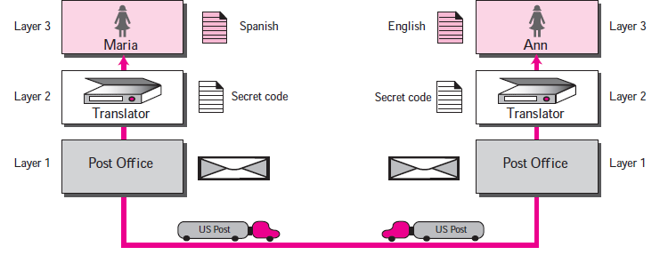
PROTOCOL LAYERS
Example ( Different Cities)
Now assume that Ann has to move to another town because of her job.

Slide 60
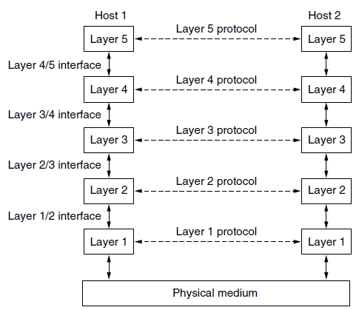
Protocol Hierarchies
To reduce their design complexity, most networks are organized as a stack of layers or levels, each one built upon the one below it.
The purpose of each layer is to offer certain services to the higher layers while shielding those layers from the details of how the offered services are actually implemented.
In reality, no data are directly transferred from layer n on one machine to layer n on another machine.
The interface defines which primitive operations and services the lower layer makes available to the upper one.

Slide 61

THE OSI MODEL
This model is based on a proposal developed by the International Standards Organization (ISO) as a first step toward international standardization of the protocols used in the various layers.
The model is called the Open Systems Interconnection (OSI) Reference Model because it deals with connecting open systems. It was first introduced in the late 1970s.
An open system is a set of protocols that allows any two different systems to communicate regardless of their underlying architecture.

Slide 62
THE OSI MODEL
The purpose of the OSI model is to show how to facilitate communication between different systems without requiring changes to the logic of the underlying hardware and software.
The OSI model is not a protocol; it is a model for understanding and designing a network architecture that is flexible, robust, and interoperable.
The OSI model is a layered framework for the design of network systems that allows communication between all types of computer systems.

Slide 63
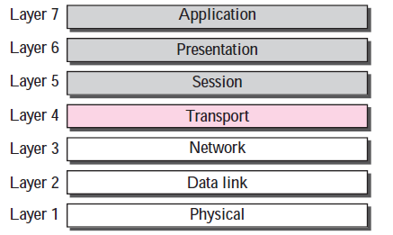
THE OSI MODEL
It consists of seven separate but related layers, each of which defines a part of the process of moving information across a network .
The user support layers
links the two subgroups
The network support layers

Slide 64
Layered Architecture
Interfaces between Layers: Each interface defines what information and services a layer must provide for the layer above it.
The upper OSI layers are almost always implemented in software; lower layers are a combination of hardware and software, except for the physical layer, which is mostly hardware.

Slide 65
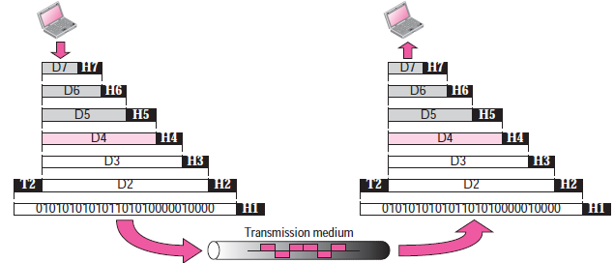
Encapsulation
The process starts at layer 7 (the application layer), then moves from layer to layer in descending, sequential order. At each layer, a header can be added to the data unit. At layer 2, a trailer may also be added. When the formatted data unit passes through the physical layer (layer 1), it is changed into an electromagnetic signal and transported along a physical link.
Segment
Packet
Frame
Bits
A packet at level 7 is encapsulated in the packet at level 6. The whole packet at level 6 is encapsulated in a packet at level 5, and so on.

Slide 66
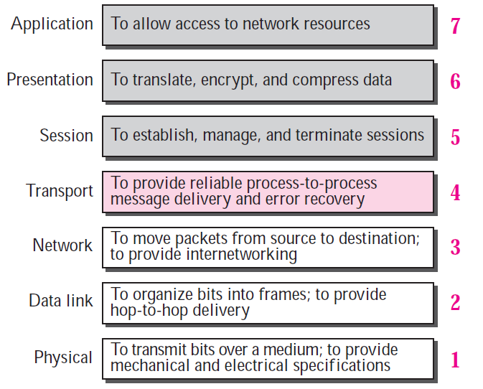
OSI Layers

Slide 67
TCP/IP PROTOCOL SUITE
The first layered protocol model for internetwork communications was created in the early 1970s and is referred to as the Internet model. It defines four categories of functions that must occur for communications to be successful. The architecture of the TCP/IP protocol suite follows the structure of this model. Because of this, the Internet model is commonly referred to as the TCP/IP model.
The TCP/IP protocol suite was developed prior to the OSI model. Therefore, the layers in the TCP/IP protocol suite do not match exactly with those in the OSI model. The original TCP/IP protocol suite was defined as four software layers built upon the hardware.

Slide 68
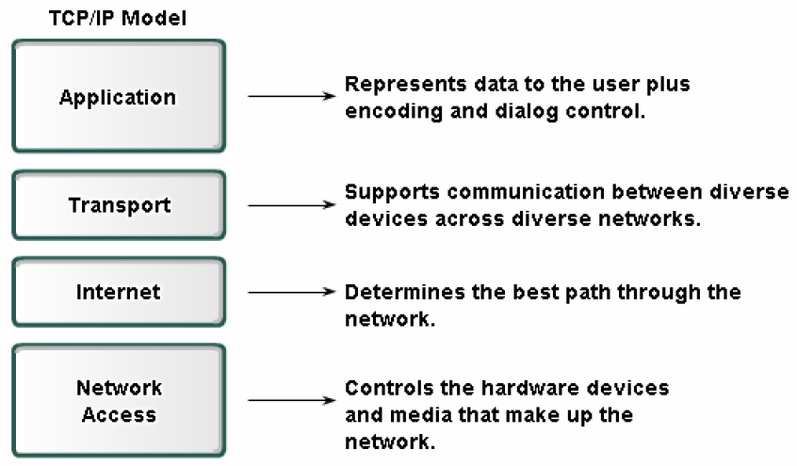
TCP/IP PROTOCOL SUITE

Slide 69
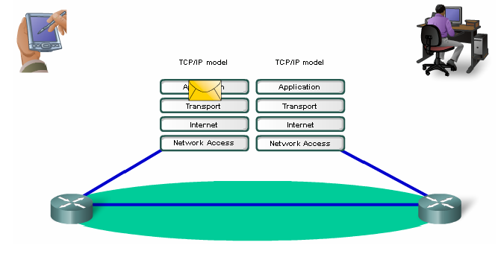
TCP/IP PROTOCOL SUITE

Slide 70
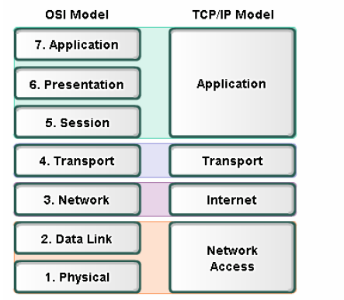
TCP/IP PROTOCOL SUITE

Slide 71
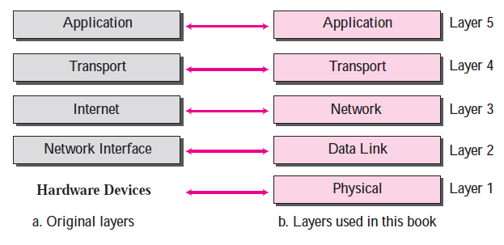
TCP/IP PROTOCOL SUITE
Today, TCP/IP is thought of as a five-layer model with the layers named similarly to the ones in the OSI model.

Slide 72
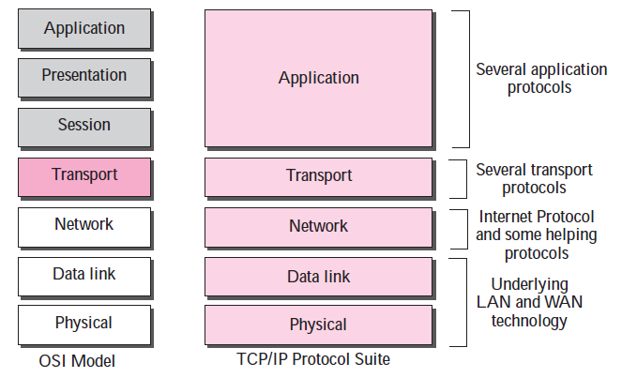
Comparison between OSI and TCP/IP Protocol Suite
Here, two layers, session and presentation, are missing from the TCP/IP protocol suite. These two layers were not added to the TCP/IP protocol suite after the publication of the OSI model. The application layer in the suite is usually considered to be the combination of three layers in the OSI model.

Slide 73
Comparison between OSI and TCP/IP Protocol Suite
Two reasons were mentioned for this decision.
First, TCP/IP has more than one transport-layer protocol. Some of the functionalities of the session layer are available in some of the transport layer protocols.
Second, the application layer is not only one piece of software. Many applications can be developed at this layer. If some of the functionalities mentioned in the session and presentation are needed for a particular application, it can be included in the development of that piece of software.

Slide 74
Physical Layer (1) TCP/IP
TCP/IP does not define any specific protocol for the physical layer. It supports all of the standard and proprietary protocols.
At this level, the communication is between two nodes, either a computer or router.
The unit of communication is a single bit. When the connection is established between the two nodes, a stream of bits is flowing between them. The physical layer, however, treats each bit individually.

Slide 75
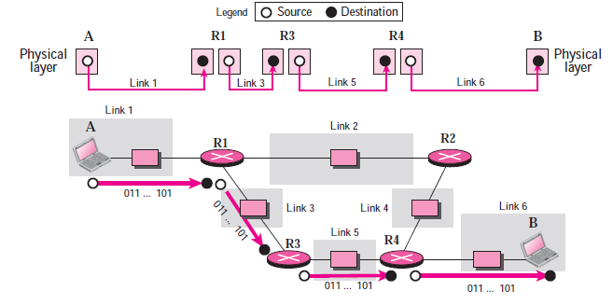
Physical Layer (1) TCP/IP
We are assuming that at this moment the two computers have discovered that the most efficient way to communicate with each other is via routers R1, R3, and R4.

Slide 76
Physical Layer (1) TCP/IP
Computer A sends each bit to router R1 in the format of the protocol used by link 1. Router 1 sends each bit to router R3 in the format dictated by the protocol used by link 3. And so on.
Note that if a node is connected to n links, it needs n physical-layer protocols, one for each link.

Slide 77
Data Link Layer (2) TCP/IP
TCP/IP does not define any specific protocol for the data link layer either. It supports all of the standard and proprietary protocols.
At this level, the communication is also between two hops or nodes. The unit of communication however, is a packet called a frame.
A frame is a packet that encapsulates the data received from the network layer with an added header and sometimes a trailer.
The head includes the source and destination of frame. The destination address is needed to define the right recipient of the frame. The source address is needed for possible response or acknowledgment as may be required by some protocols.

Slide 78
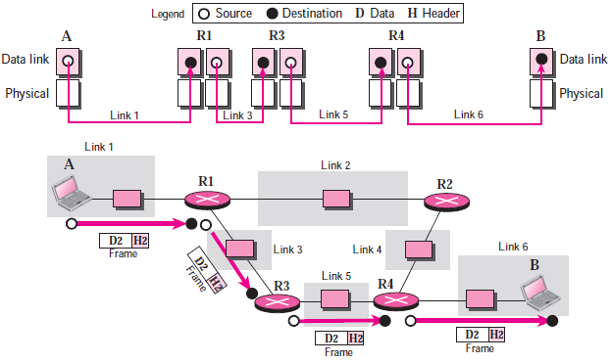
Data Link Layer
Note that the frame that is travelling between computer A and router R1 may be different from the one travelling between router R1 and R3.
When the frame is received by router R1, this router passes the frame to the data link layer protocol (left). The frame is opened, the data are removed.
The data are then passed to the data link layer protocol (right) to create a new frame to be sent to the router R3.

Slide 79
Network Layer(3) TCP/IP
At the network layer (or, more accurately, the internetwork layer), TCP/IP supports the Internet Protocol (IP).
The Internet Protocol (IP) is the transmission mechanism used by the TCP/IP protocols.
IP transports data in packets called Datagrams, each of which is transported separately. Datagrams can travel along different routes and can arrive out of sequence or be duplicated.
IP does not keep track of the routes and has no facility for reordering datagrams once they arrive at their destination.

Slide 80
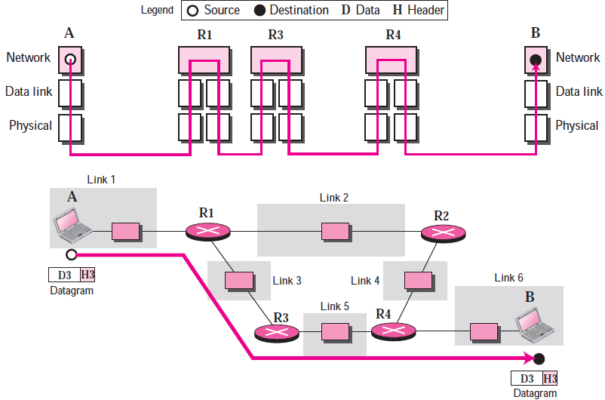
Network Layer(3) TCP/IP

Slide 81
Network Layer(3) TCP/IP
Note that there is a main difference between the communication at the network layer and the communication at data link or physical layers:
Communication at the network layer is end to end while the communication at the other two layers are node to node.
The datagram started at computer A is the one that reaches computer B. The network layers of the routers can inspect (check) the source and destination of the packet for finding the best route, but they are not allowed to change the contents of the packet.

Slide 82
Transport Layer (4) TCP/IP
There is a main difference between the transport layer and the network layer.
Although all nodes in a network need to have the network layer, only the two end computers need to have the transport layer.
The network layer is responsible for sending individual datagrams from computer A to computer B; the transport layer is responsible for delivering the whole message, which is called a Segment, a user datagram, or a packet, from A to B.
A segment may consist of a few or tens of datagrams. The segments need to be broken into datagrams and each datagram has to be delivered to the network layer for transmission.

Slide 83
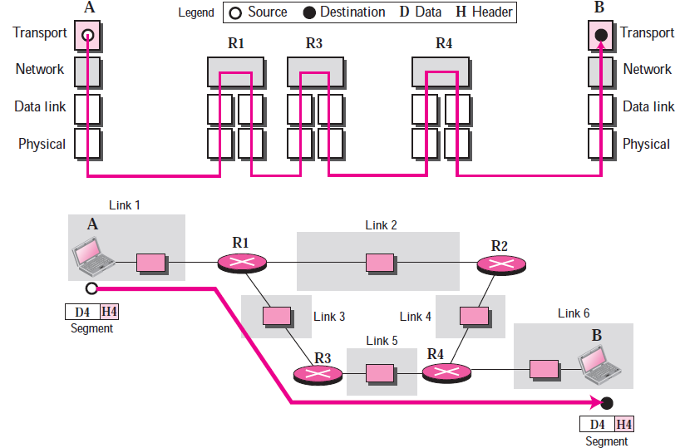
Transport Layer (4) TCP/IP
Since the Internet defines a different route for each datagram, the datagrams may arrive out of order and may be lost. The transport layer at computer B needs to wait until all of these datagrams to arrive, assemble them and make a segment out of them.

Slide 84
Transport Layer (4) TCP/IP
Traditionally, the transport layer was represented in the TCP/IP suite by two protocols:
1- Transmission Control Protocol (TCP): is a reliable connection-oriented protocol that allows a byte stream originating on one machine to be delivered without error on any other machine in the internet. TCP also handles flow control to make sure a fast sender cannot swamp a slow receiver with more messages than it can handle.
2- User Datagram Protocol (UDP): UDP is an unreliable, connectionless protocol for applications that do not want TCP’s sequencing or flow control and wish to provide their own. It is also widely used for one-shot, client-server-type request-reply queries and applications in which prompt delivery is more important than accurate delivery, such as transmitting speech or video. Its advantage low overhead.
3- A new protocol called Stream Control Transmission Protocol (SCTP) has been introduced in the last few years.

Slide 85
Application Layer (5) TCP/IP
The application layer in TCP/IP is equivalent to the combined session, presentation, and application layers in the OSI model. The application layer allows a user to access the services of our private internet or the global Internet. Many protocols are defined at this layer to provide services such as electronic mail, file transfer, accessing the World Wide Web, and so on.
Note that the communication at the application layer, like the one at the transport layer, is end to end. A message generated at computer A is sent to computer B without being changed during the transmission.

Slide 86
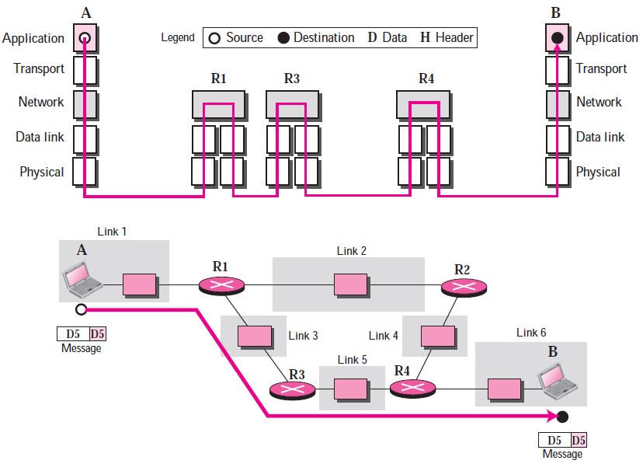
Transport Layer (5) TCP/IP

Slide 87
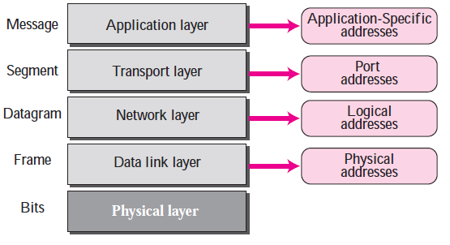
ADDRESSING
Four levels of addresses are used in an internet employing the TCP/IP protocols: physical address, logical address, port address, and application-specific address. Each address is related to a one layer in the TCP/IP architecture:

Slide 88
1.4 Additional Security Principles
Modern security emphasizes:
- Authentication - Verifying identity.
- Authorization - Defining access rights.
- Accountability - Tracking actions.
- Non-repudiation - Preventing denial of actions.
- Reliability - Ensuring consistent performance.

Slide 89
1.8 Security Measures
1. Technical Controls: Encryption, firewalls.
2. Administrative Controls: Policies, training.
3. Physical Controls: Locks, CCTV.
4. Incident Response Plans.
5. Regular updates and patching.

Slide 90
1.10 Challenges in Information Security
Challenges include:
- Rapidly evolving threats
- Lack of skilled professionals
- Managing remote/cloud security
- Balancing usability and security
- Multi-jurisdictional compliance

Slide 91
1.11 Summary
Information security ensures data confidentiality, integrity, and availability, building trust in digital systems. As threats grow, continuous security improvements are necessary.

